Slide 1
Mathematics for business decisions
Lecture 5
Chapter 3
Percents
Textbook: Business Mathematics by Gary Clendenen and Stanley Salzman

Slide 2
Percents
Similar to fractions and decimals, percents represent parts of a whole.
Percents (hundredths) mean parts out of 100.
Written using a percent sign (%).
For example 1% means 1 of 100 equal parts.
The number 12% is read “twelve percent.”

Slide 3
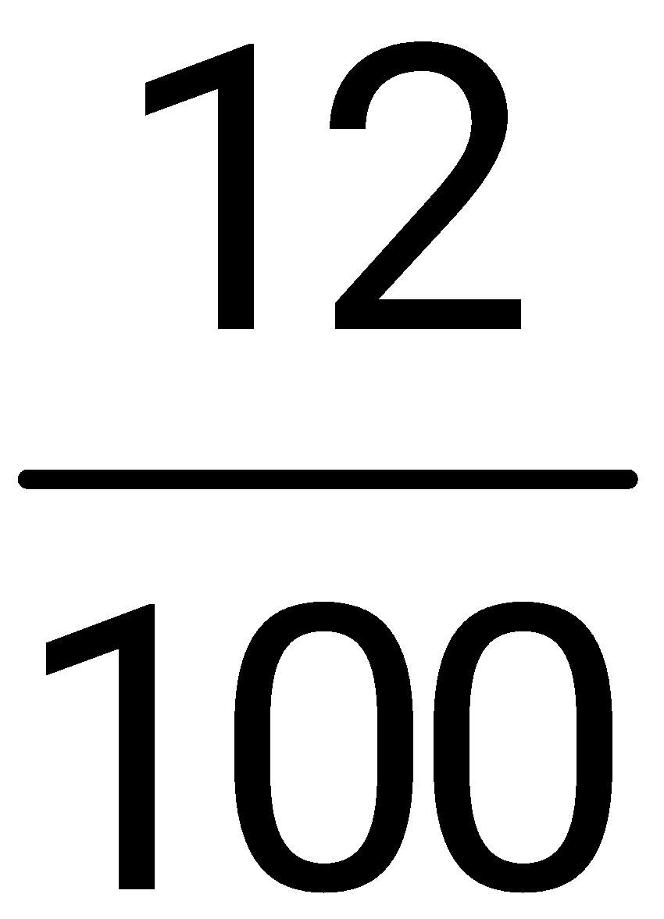
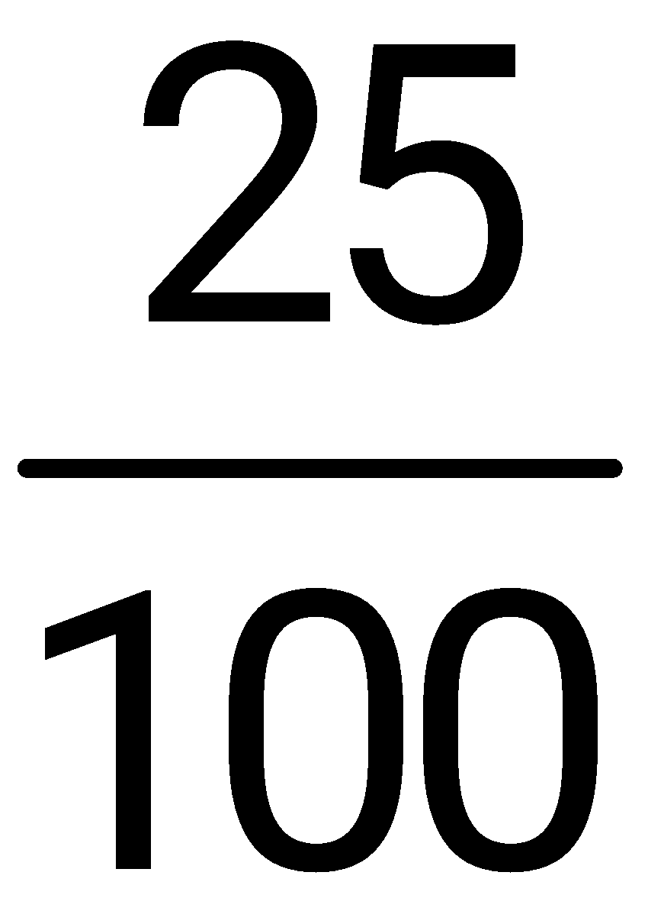
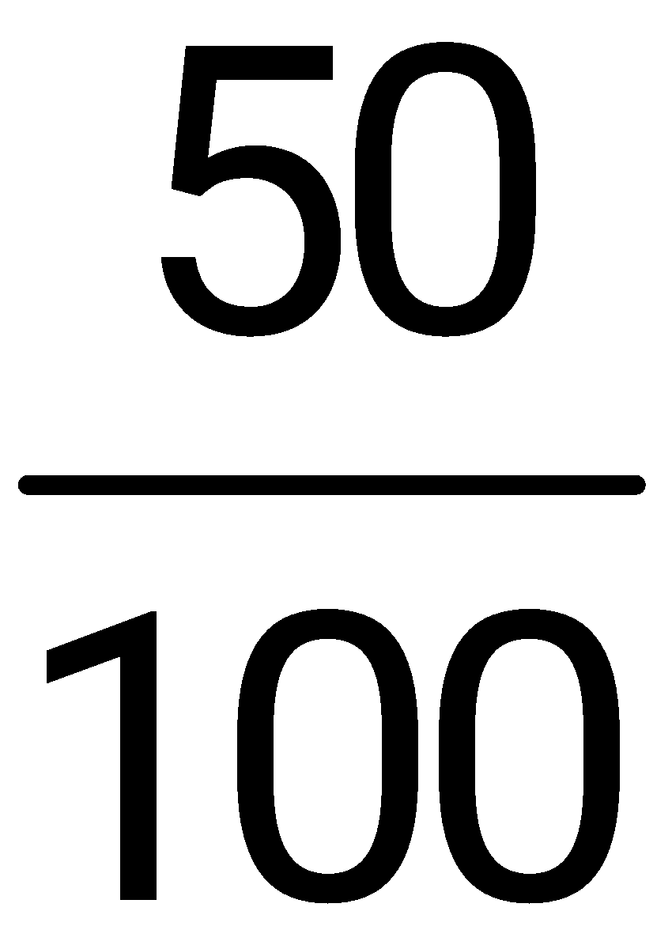
Percents
Decimal
Fraction
12% = 12 out of 100 equal parts .12
25% = 25 out of 100 equal parts .25
50% = 50 out of 100 equal parts .50

Slide 4
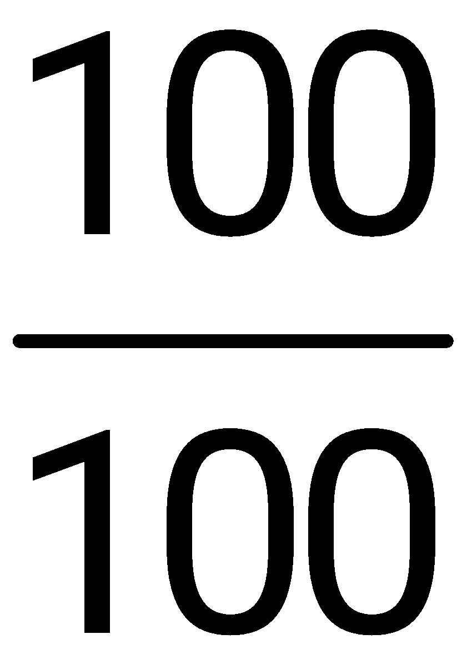
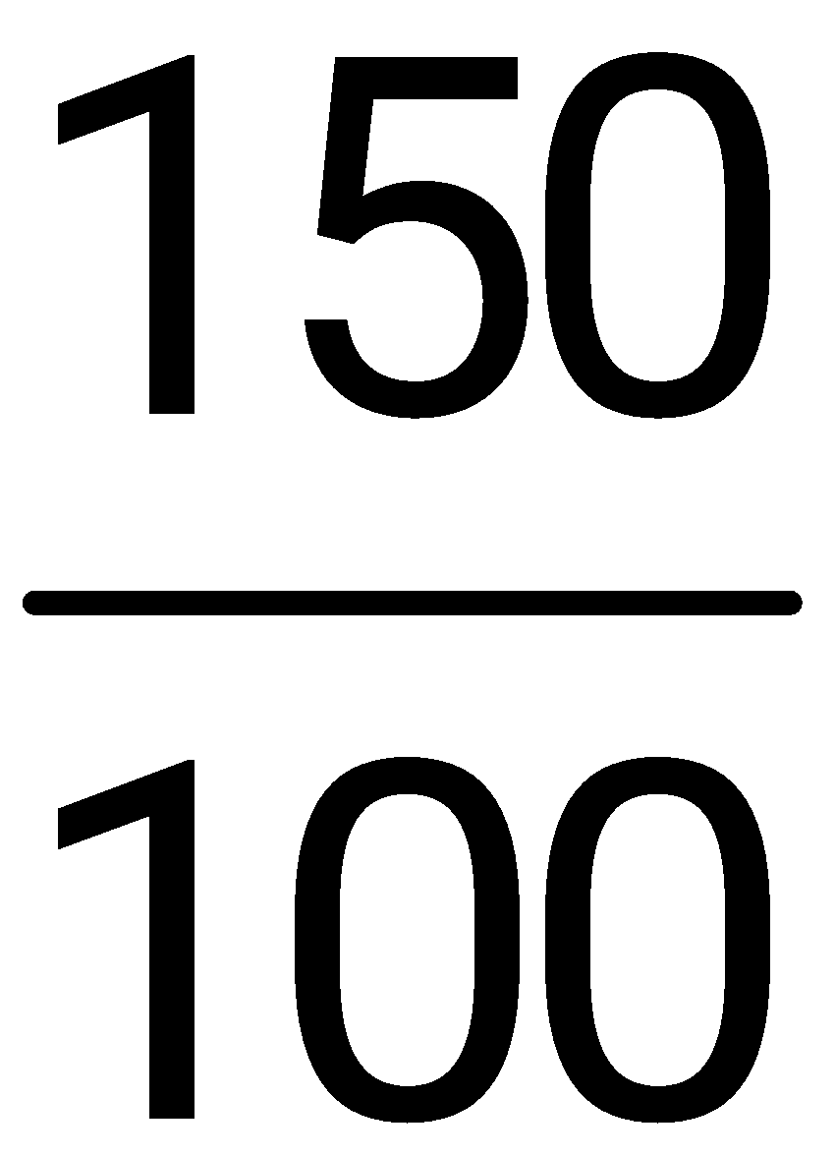
Percents
Decimal
Fraction
100% = 100 out of 100 equal parts 1.00
150% = 150 out of 100 equal parts 1.50

Slide 5
Converting a decimal number to a percent
Step 1 Move the decimal point two digits to the right attaching trailing zeros as needed.
You are effectively multiplying by 100.
Step 2 Attach a percent sign.
.75 = 75%

Slide 6
Example
Change the following decimals to percents.
(a) .35
(b) .42
(c) .58
= 35%
= 42%
= 58%

Slide 7
Example
Change the following decimals to percents.
(a) .8
(b) 2.6
(c) .1
(d) 4
= 80%
= 260%
= 10%
= 400%

Slide 8
Example
Change the following decimals to percents.
(a) .625
(b) .0057
(c) 1.25
= 62.5%
= .57%
= 125%

Slide 9
Write a Fraction as a Percent
Write the fraction as a decimal.
Move the decimal point two places to the right.
Add a percent sign (%).

Slide 10
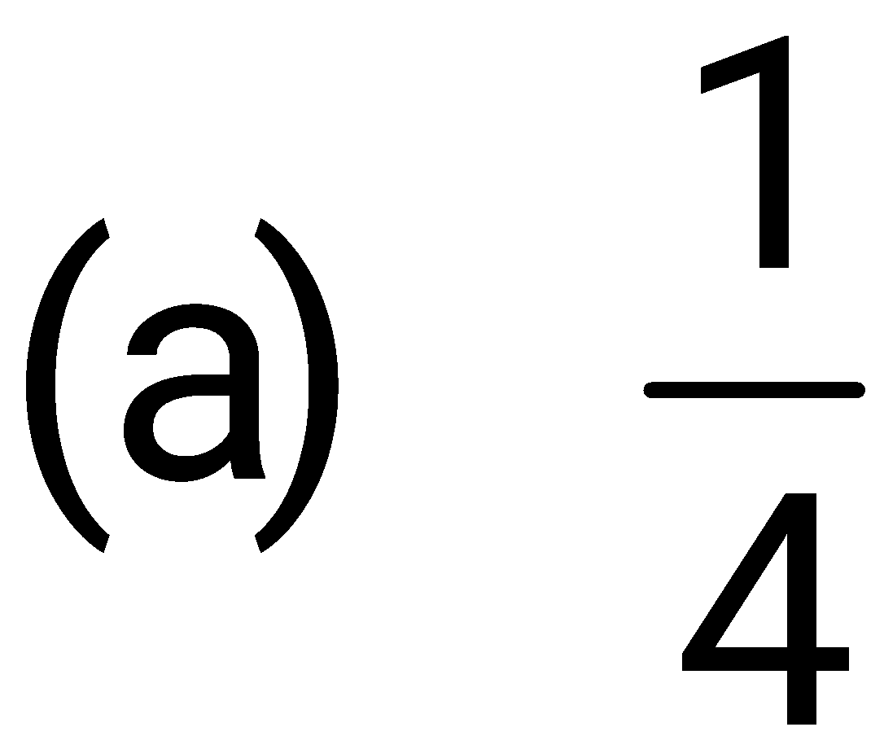
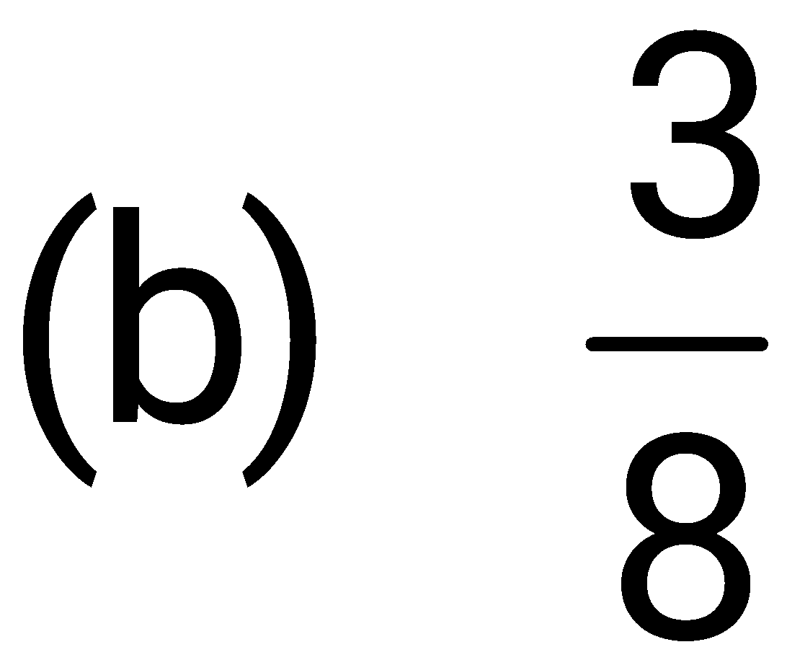
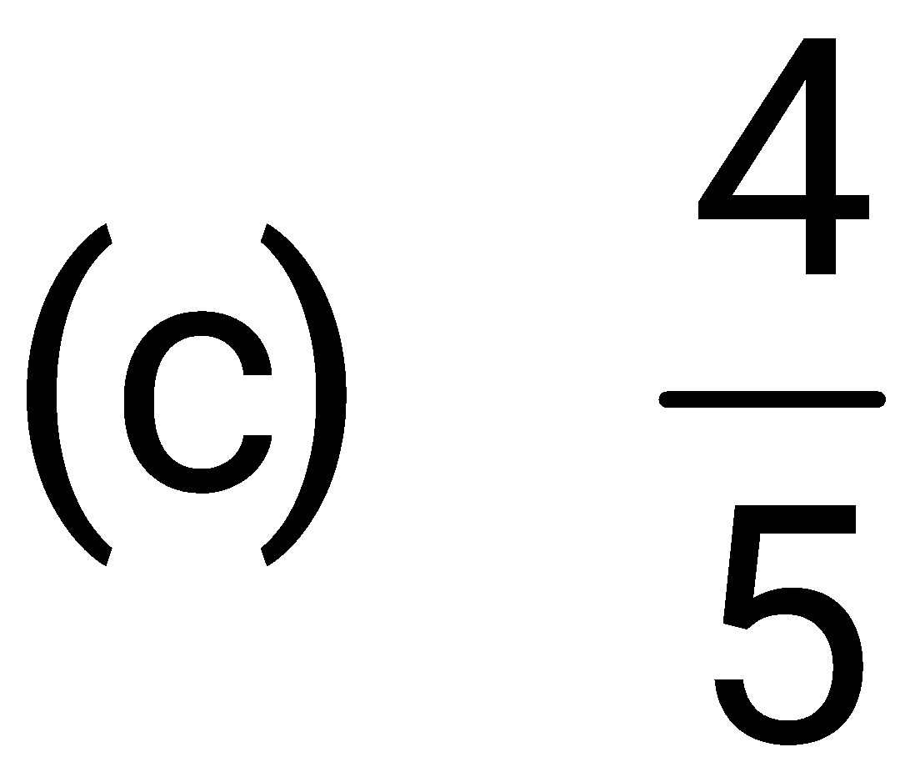
Example
A marketing manager is given the following data in fraction form and must change the data to percents.

Slide 11
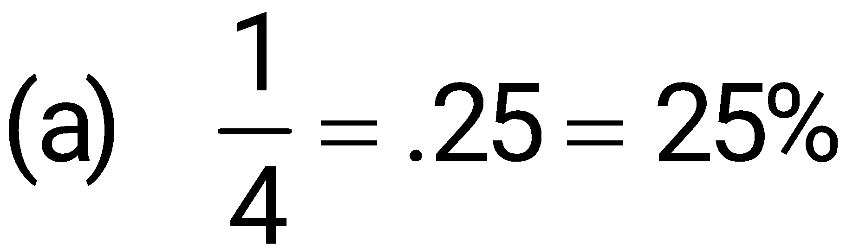
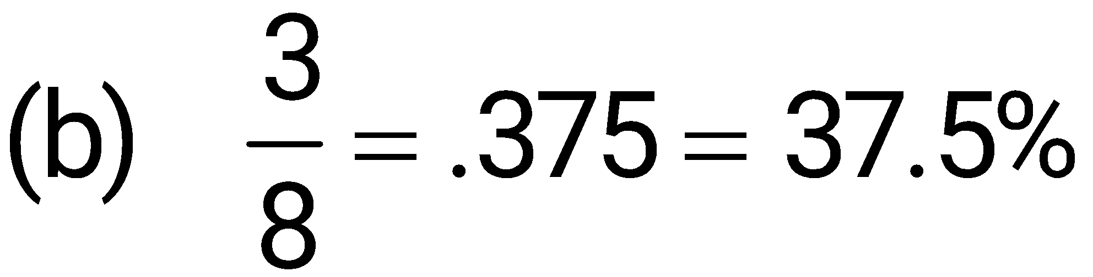
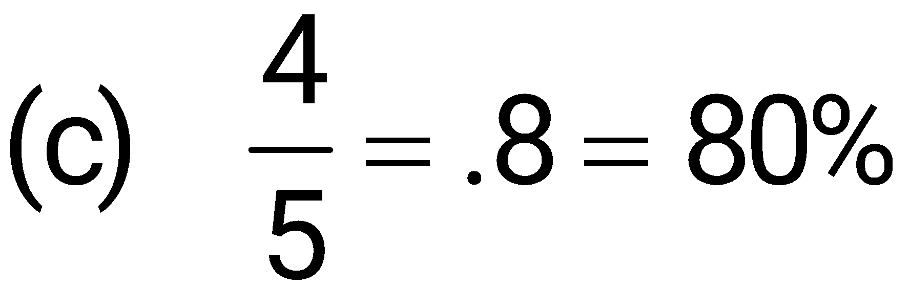
Example
First write each fraction as a decimal, and then write the decimal as a percent.

Slide 12
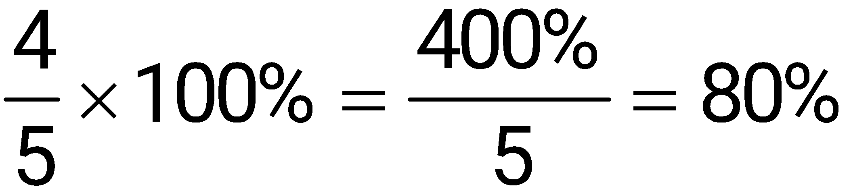
Write a Fraction as a Percent
(Second Method)
Multiply the fraction by 100%.

Slide 13
Write a Percent as a Decimal
Step 1 Drop the percent sign.
Step 2 Move the decimal point two places to the left. You are effectively dividing by 100.
25% = .25

Slide 14
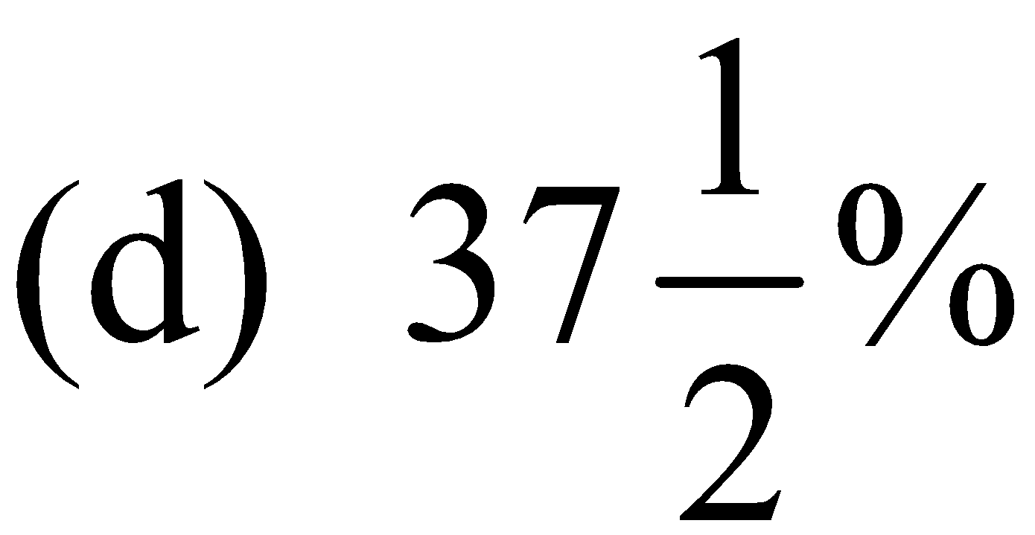
Example
To calculate some insurance claims, an insurance agent must change the following percents to decimals.
(a) 35%
(b) 50%
(c) 325%
= .35
= .375
= .5
= 3.25

Slide 15
Write a Percent as a Fraction
Change the percent to a decimal.
Write the decimal as a fraction in lowest terms.

Slide 16
Example
Even though smoking is believed to account for 1 of every 5 deaths in the United States, more than 45 million Americans smoke. The bar chart shows the percent of people in each age group that smoke. Convert each percent to a fraction and reduce to lowest terms.

Slide 17
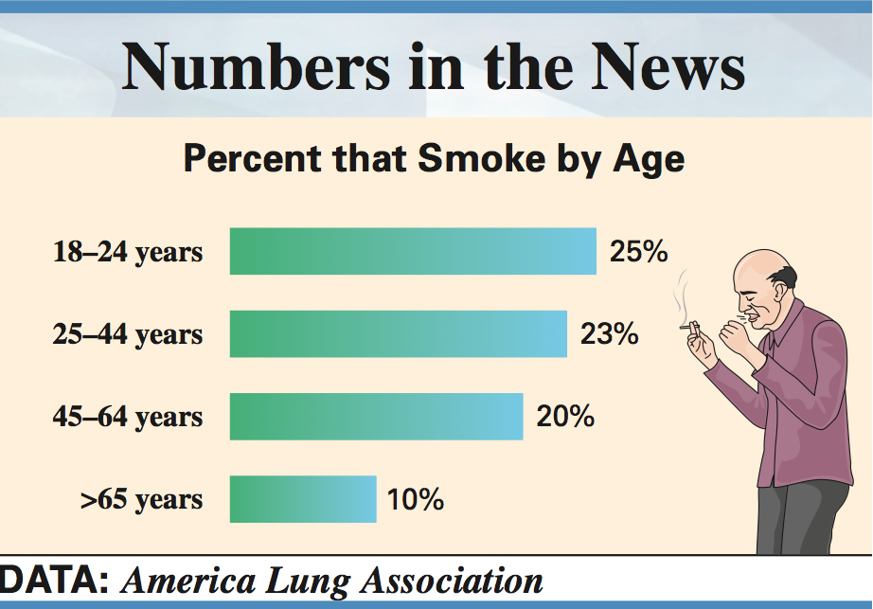
Example 6

Slide 18
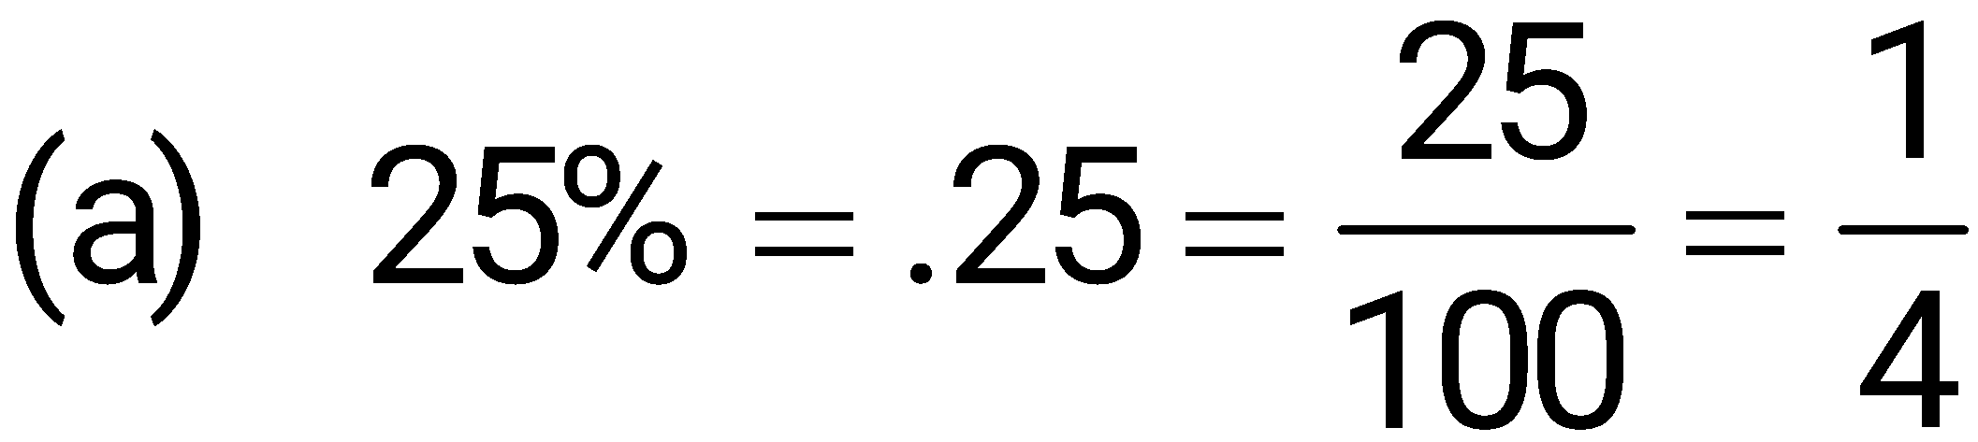
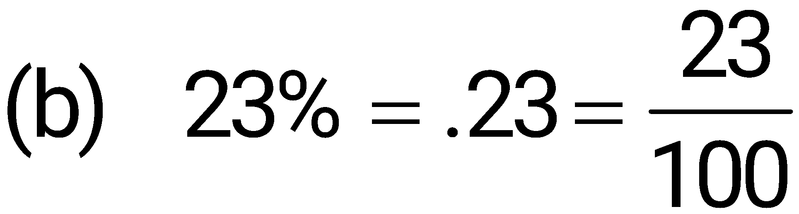
Example
Write each percent as a decimal and then as a fraction in lowest terms.

Slide 19
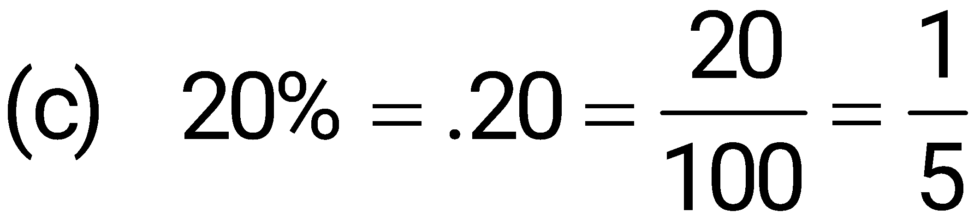
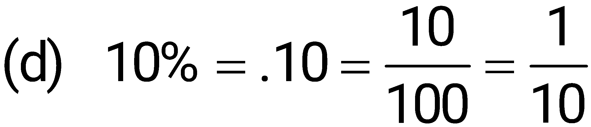
Example
Write each percent as a decimal and then as a fraction in lowest terms.

Slide 20
Write a Fractional Percent as a Decimal
Change the fraction to a decimal followed by a percent sign.
Move the decimal point two places to the left.
Drop the percent sign.

Slide 21
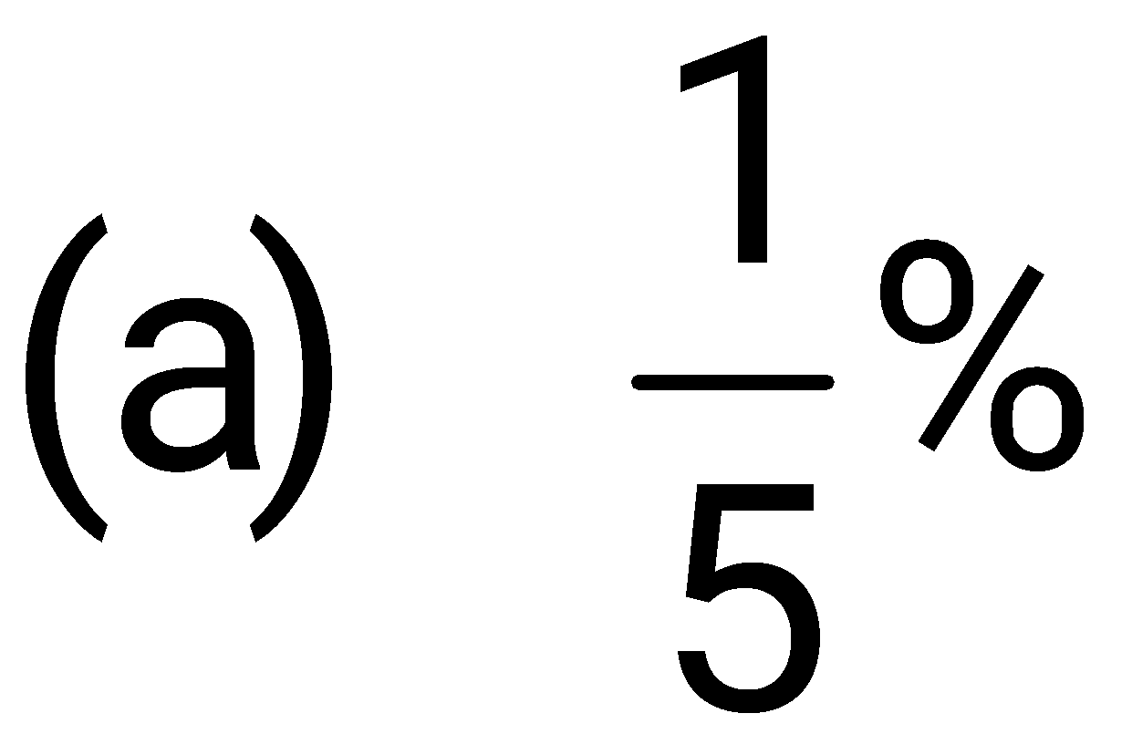
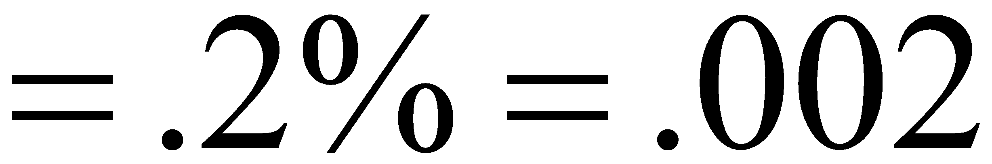
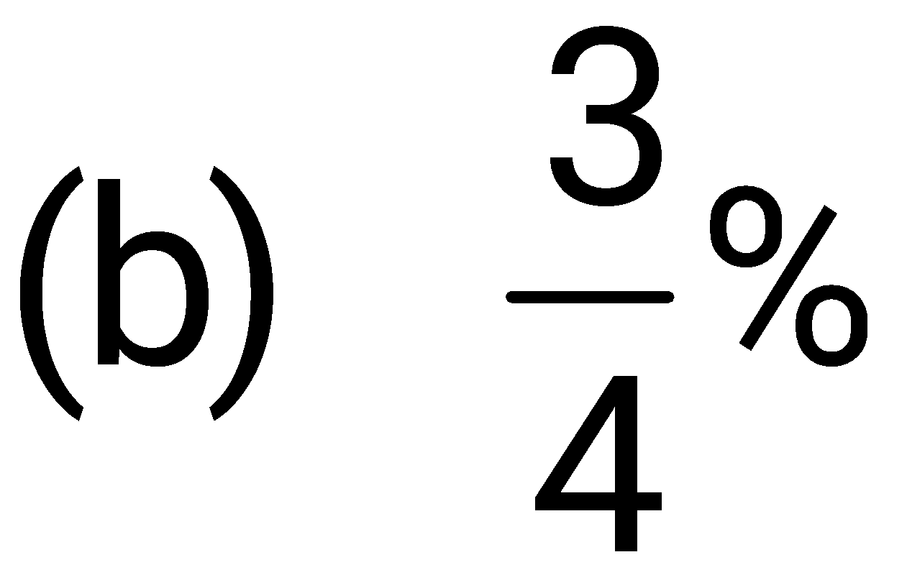
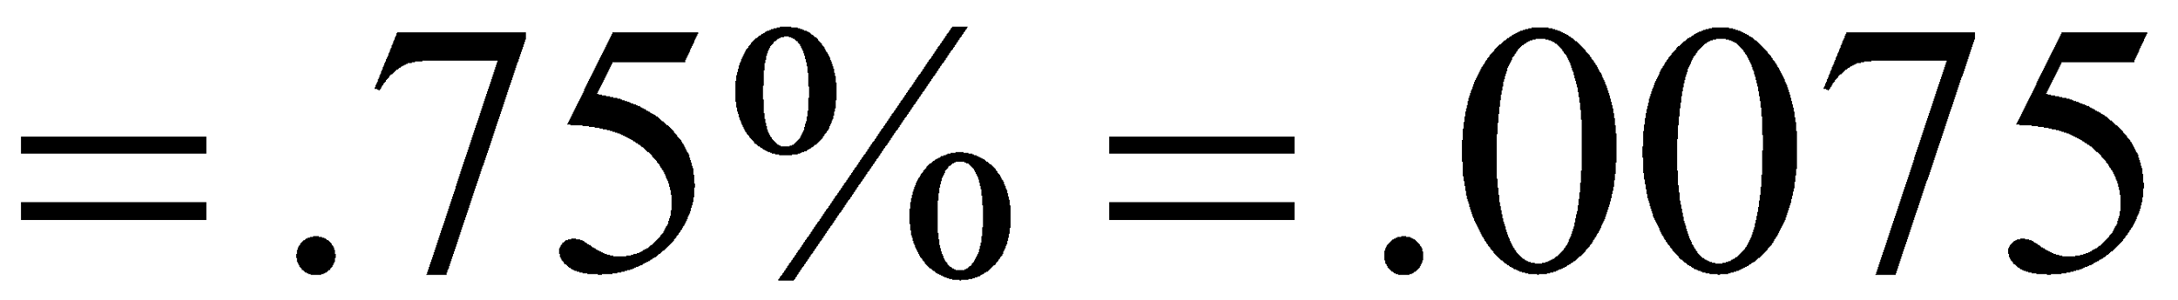
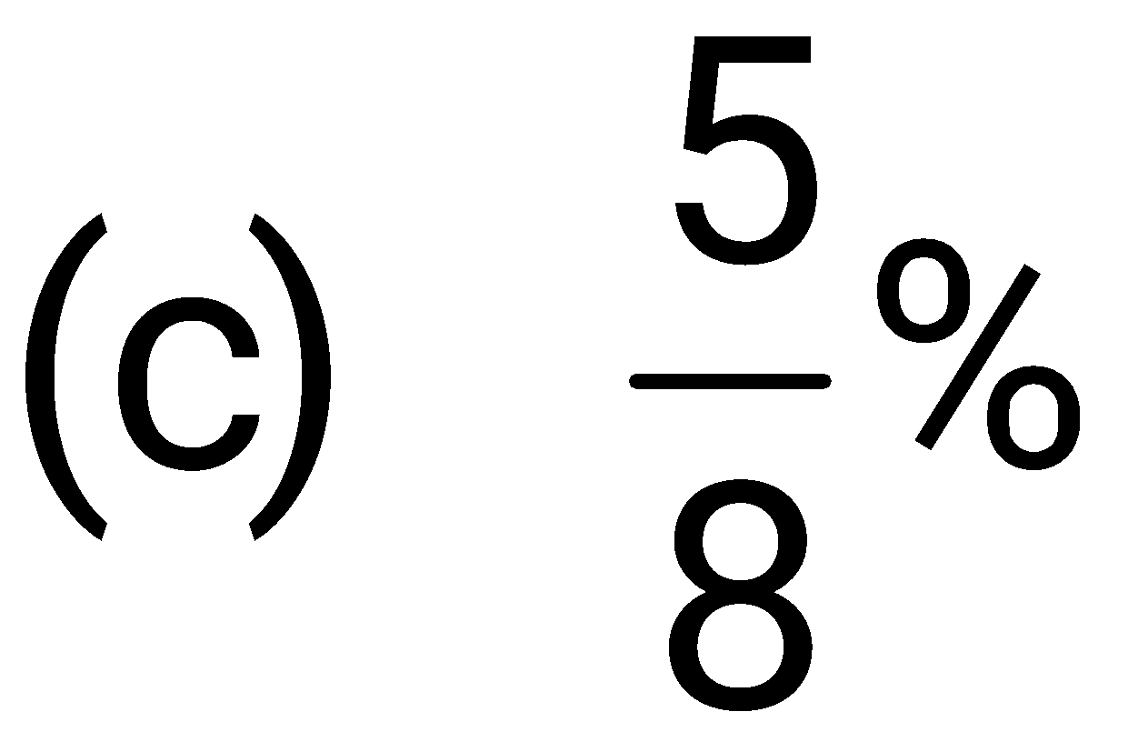
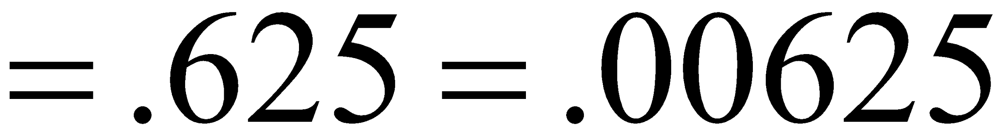
Example
The following percents appear in a newspaper article. Write each fractional percent as a decimal.

Slide 22
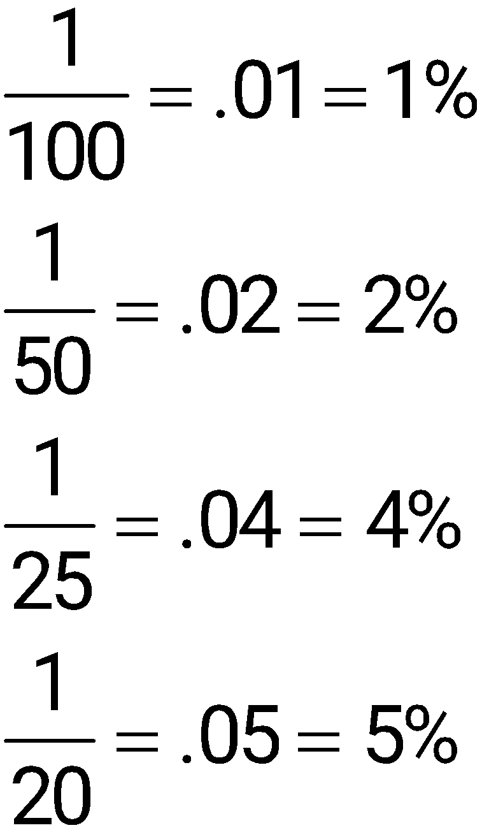
Fraction, Decimal, Percent Equivalents

Slide 23
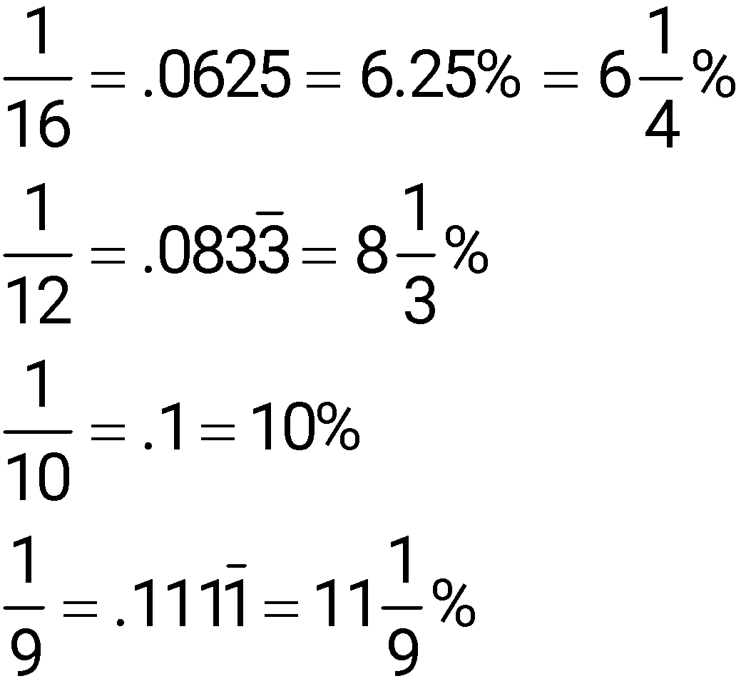
Fraction, Decimal, Percent Equivalents

Slide 24
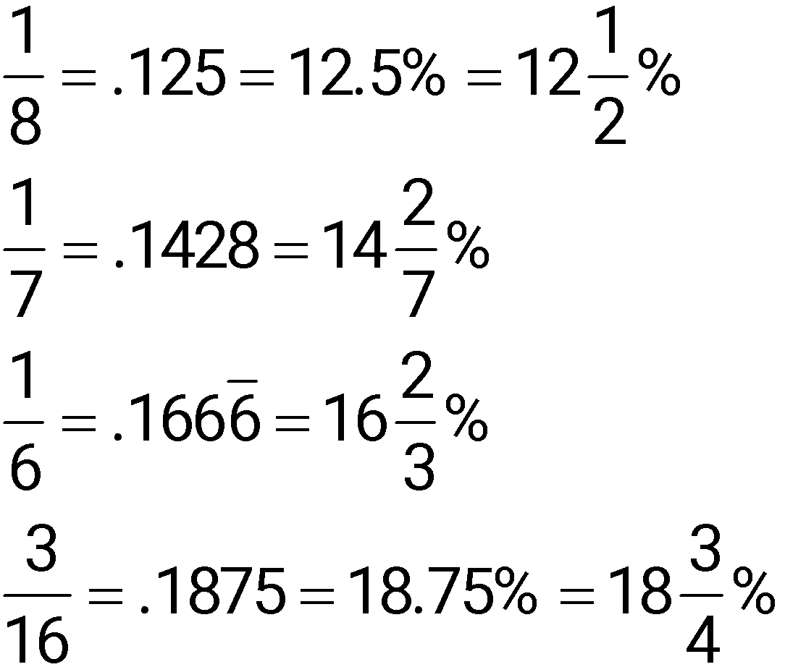
Fraction, Decimal, Percent Equivalents

Slide 25
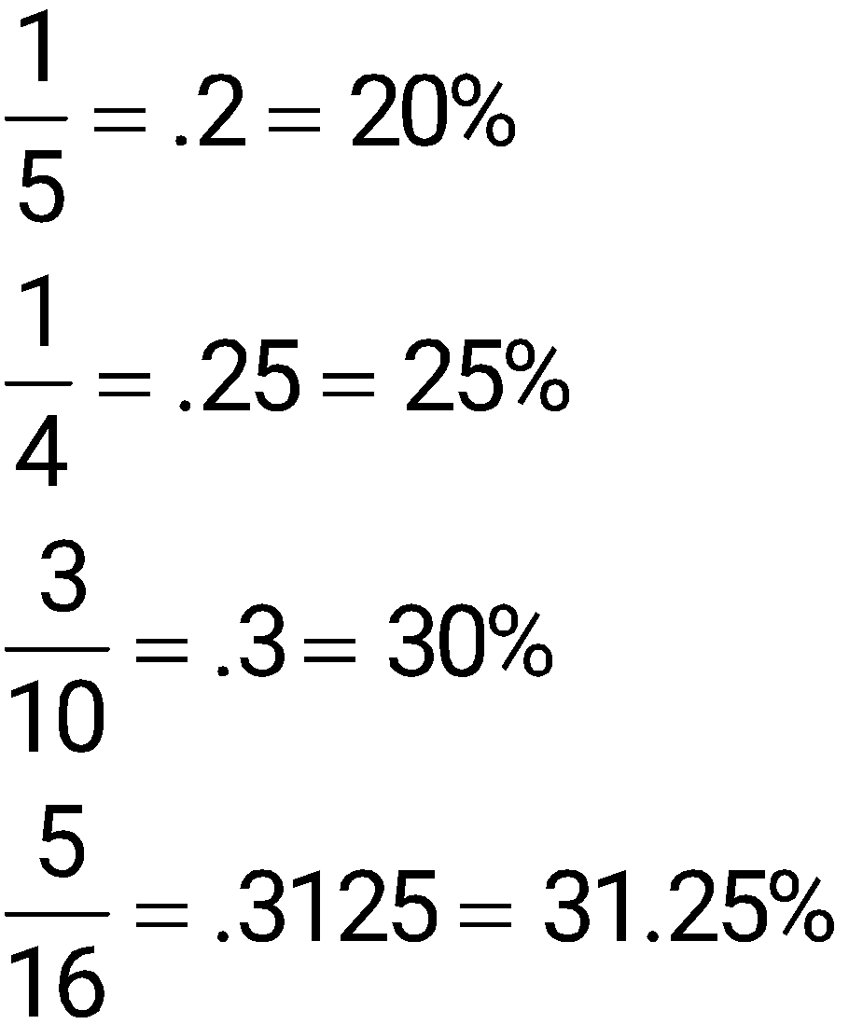
Fraction, Decimal, Percent Equivalents

Slide 26
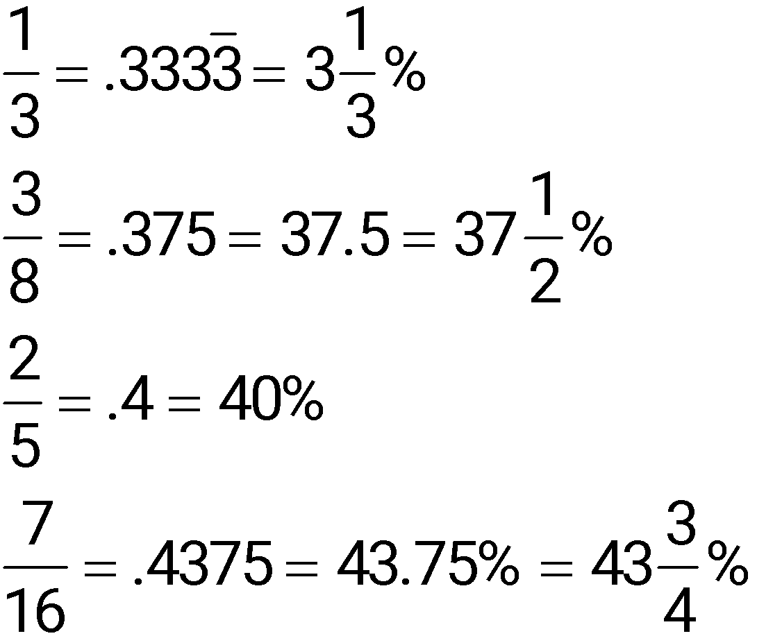
Fraction, Decimal, Percent Equivalents

Slide 27
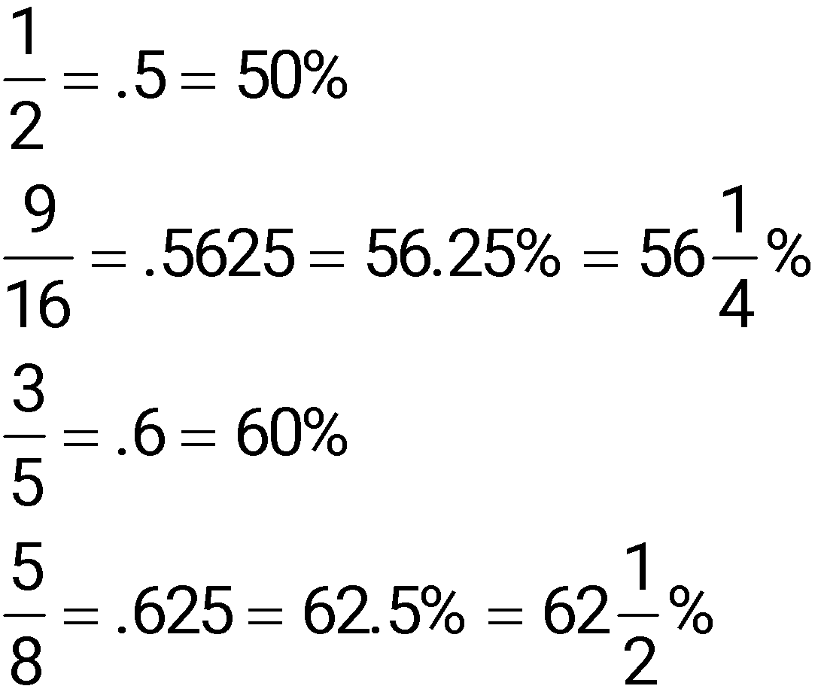
Fraction, Decimal, Percent Equivalents

Slide 28
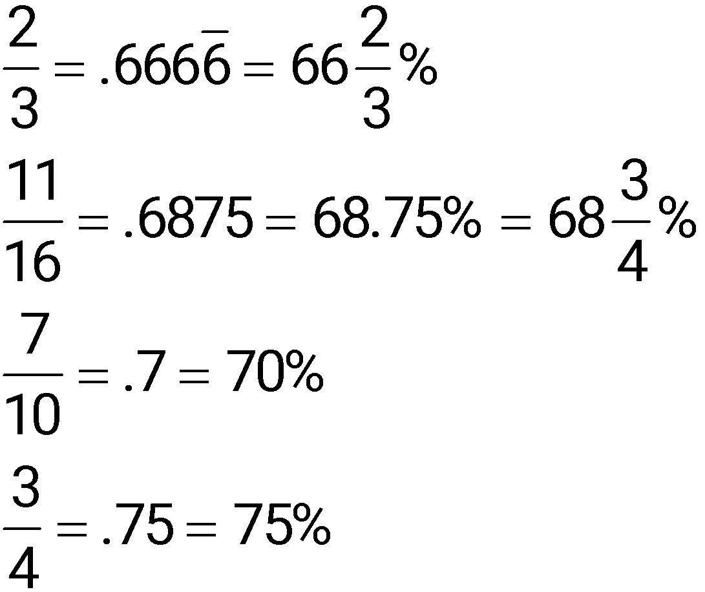
Fraction, Decimal, Percent Equivalents

Slide 29
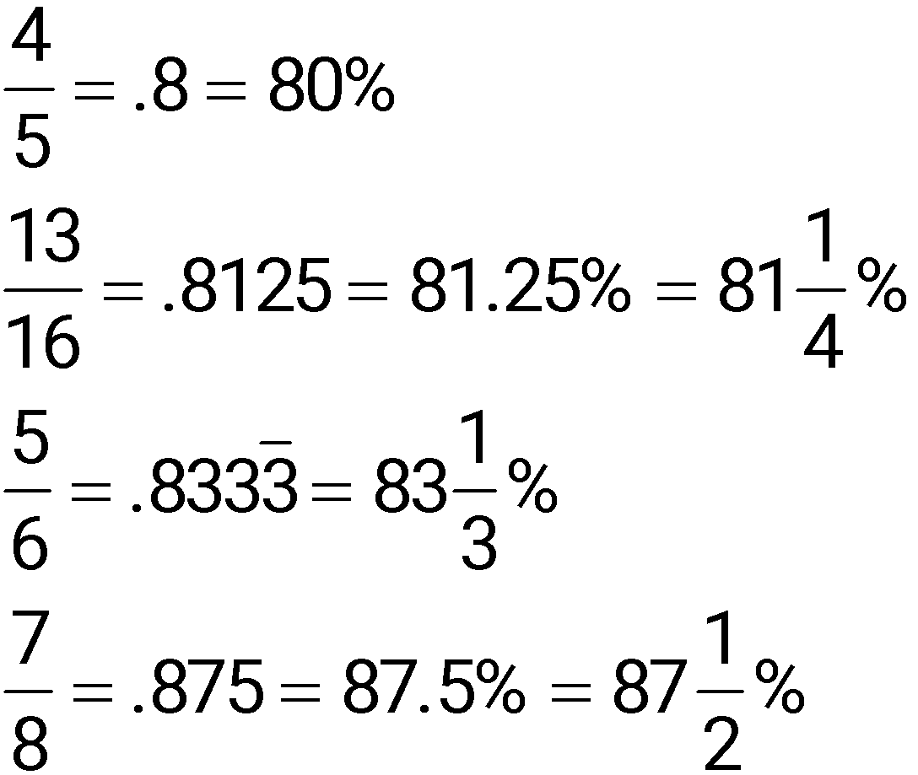
Fraction, Decimal, Percent Equivalents

Slide 30
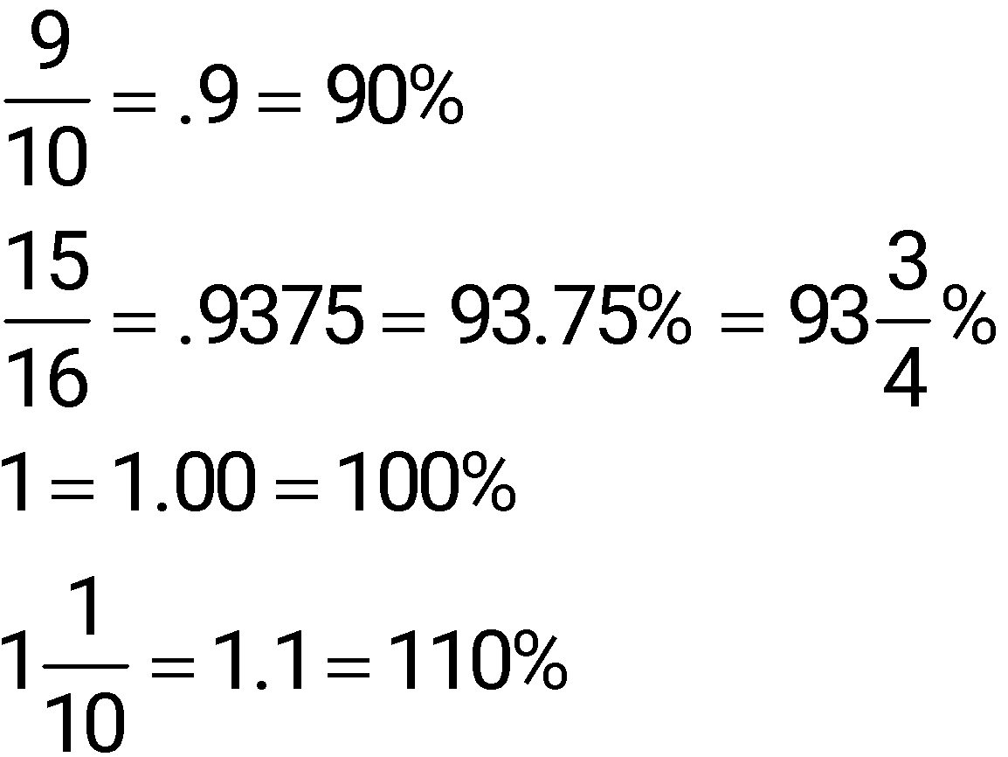
Fraction, Decimal, Percent Equivalents

Slide 31
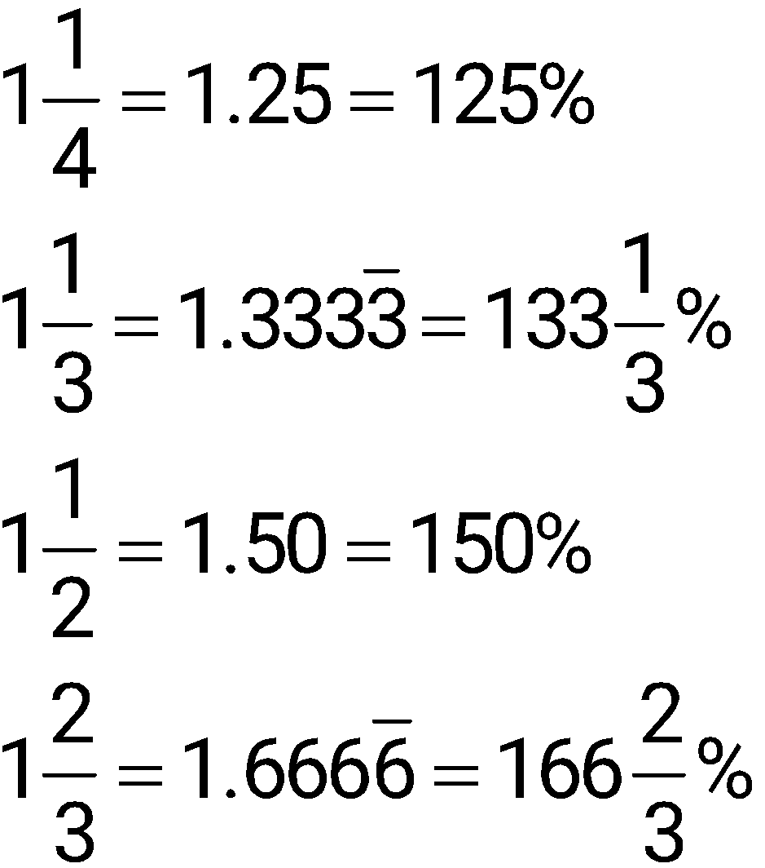
Fraction, Decimal, Percent Equivalents

Slide 32
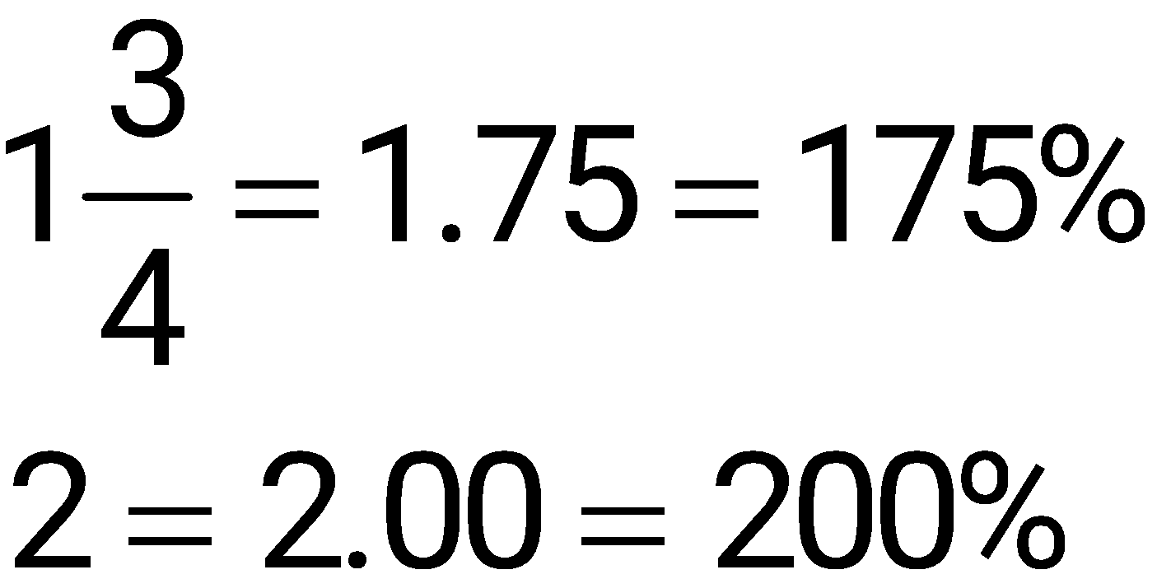
Fraction, Decimal, Percent Equivalents

Slide 33
Know the Three Components of a Percent Problem
1. Base: The whole or total, starting point, or that to which something is being compared.
2. Rate: A number followed by % or percent.
3. Part: The result of multiplying the base and the rate. The part is a part of the base. For example, sales tax is a part of total sales.

Slide 34
Learn the Basic Percent Formula
P = B × R
Part = Base × Rate
or
P = R × B
Part = Rate × Base

Slide 35
Solve for Part
Use one of the formulas:
P = B × R or
P = R × B
Substitute the known values.
Carry out the calculation.

Slide 36
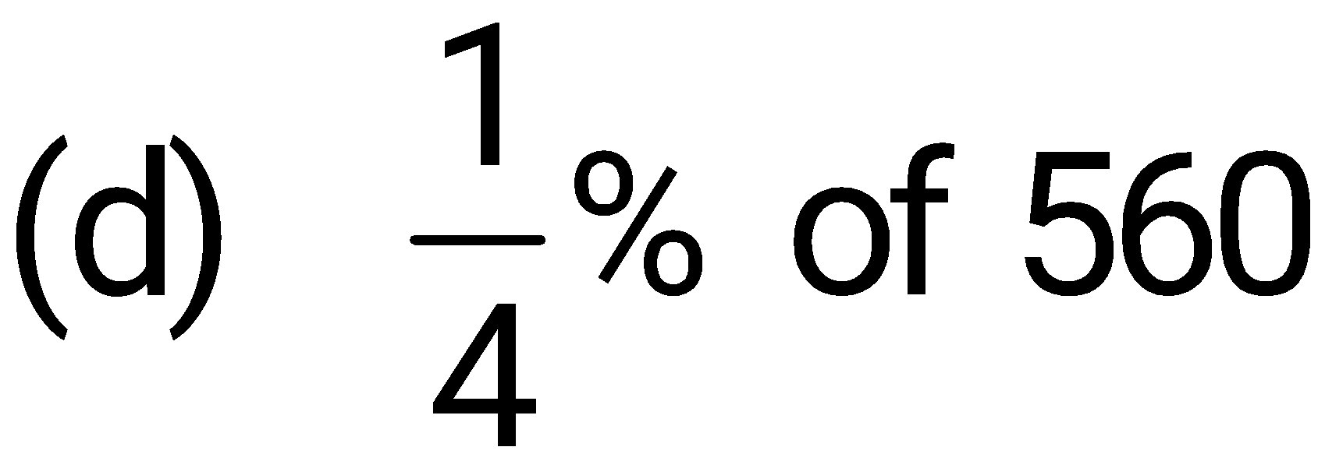
Example
Solve for part, using P = B × R.
4% of 50
(b) 1.2% of 180
(c) 140% of 225

Slide 37
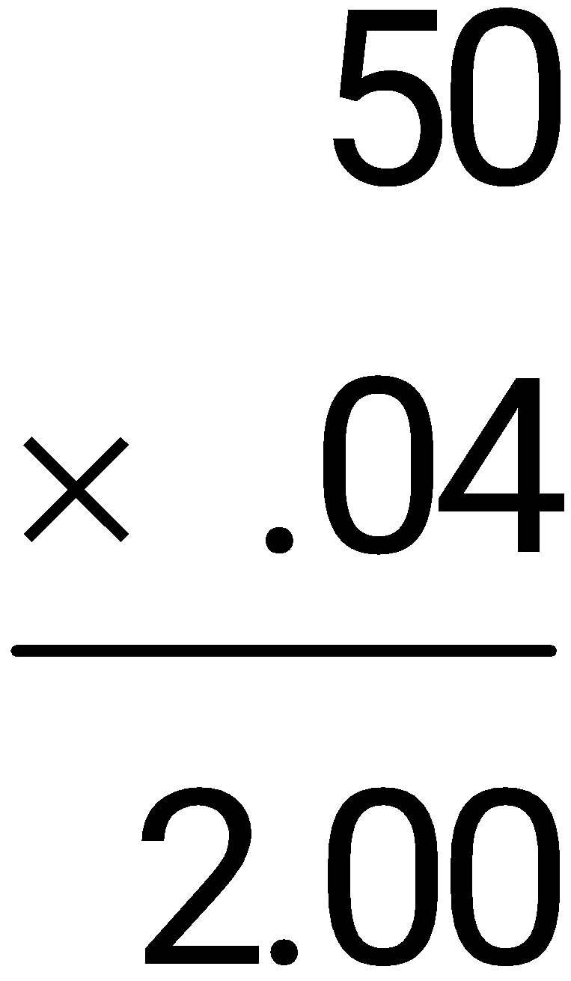
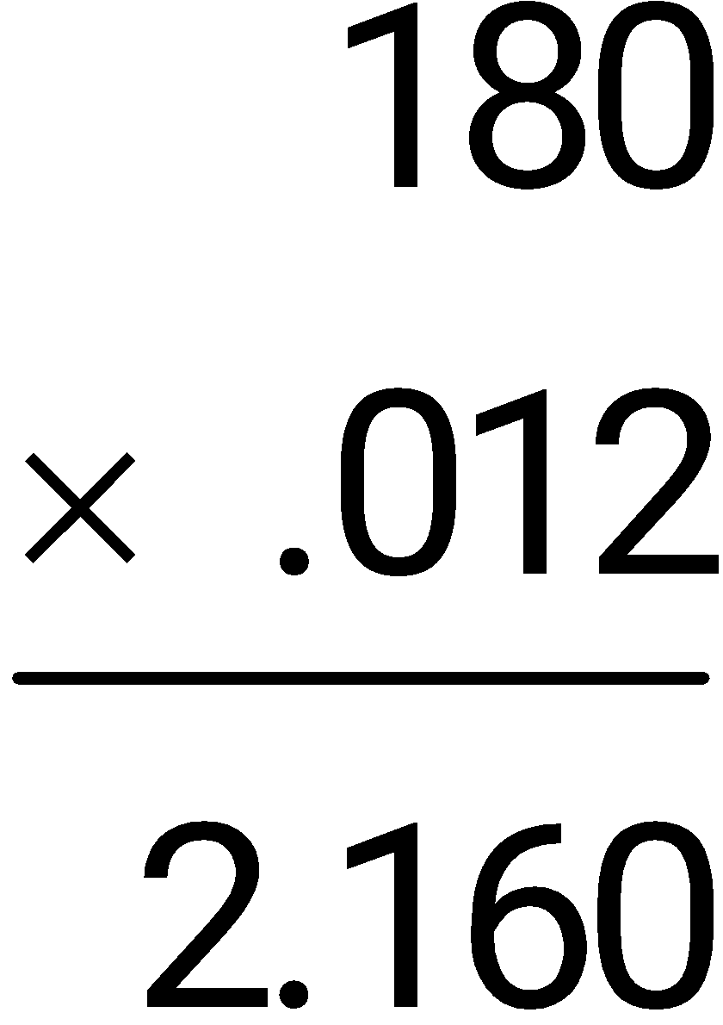
Example
Solve for part, using P = B × R.
4% of 50
(b) 1.2% of 180

Slide 38
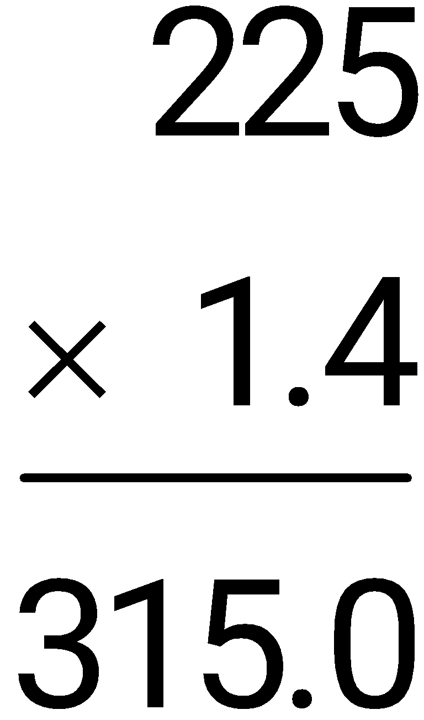
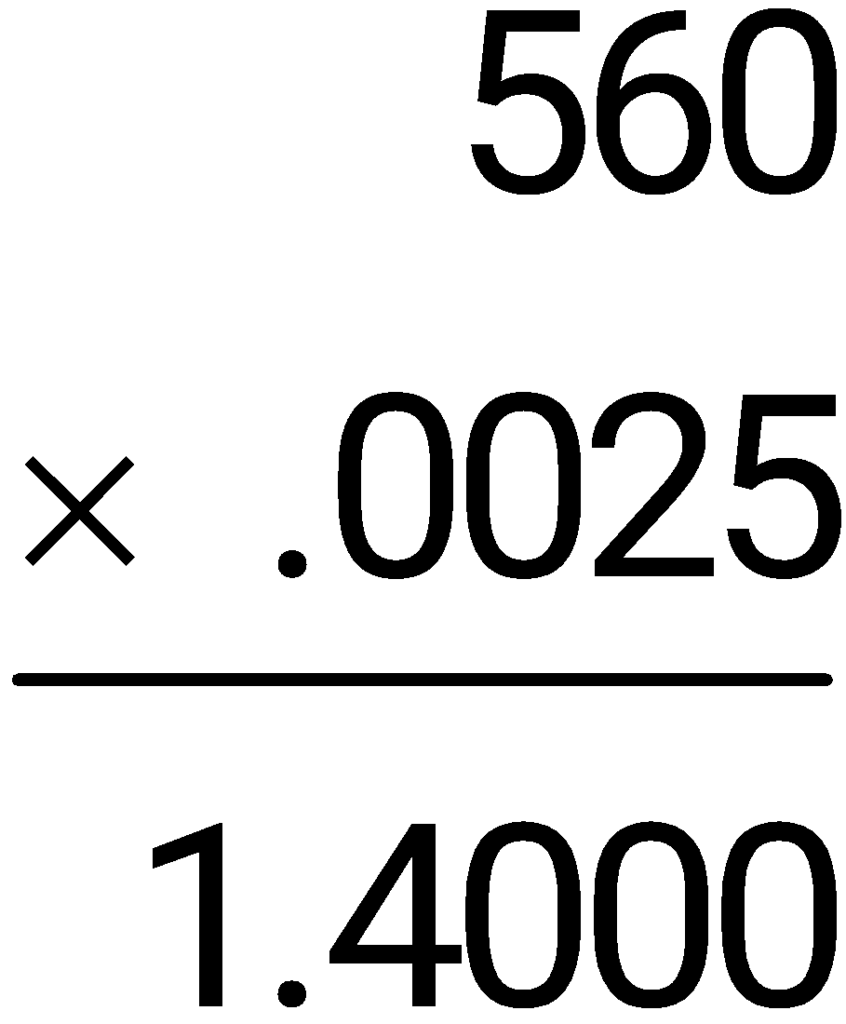
Example
Solve for part, using P = B × R.
(c) 140% of 225

Slide 39
Example
The bar graph on the next slide shows the unemployment rate by category in the midst of a serious recession. Use the data provided to estimate the number of unemployed teenagers out of a total of roughly 32,000 working-age teenagers in one city.

Slide 40
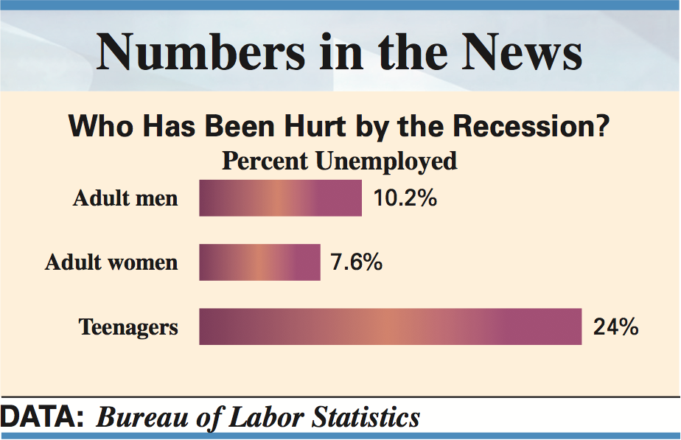
Example 2
The bar graph on the next slide shows the unemployment rate by category in the midst of a serious recession. Use the data provided to estimate the number of unemployed teenagers out of a total of roughly 32,000 working-age teenagers in one city.

Slide 41
Example
The base is 32,000. The rate for unemployed teenagers is 24%. The number of unemployed teenagers is part of the whole, so part (P) is the unknown.
P = B × R
P = 32,000 × 24%
P = 32,000 × .24 = 7680
About 7680 of the 32,000 working-age teenagers in the city are unemployed.

Slide 42
Recognize the Terms Associated with Base, Rate, and Part
Percent problems have similarities.
Some phrases are associated with the base.
Some phrases lead to the part.
% or percent identifies the rate.

Slide 43
Recognize the Terms Associated with Base, Rate, and Part
Usually indicates the base (B)
Usually indicates the part (P)
Sales
Sales tax
Investment
Return on Investment
Savings
Interest
Retail price
Discount
Last year’s figure
Increase or decrease
Old salary
Raise
Earnings
Expenditures

Slide 44
Calculate Sales Tax
Good example of finding part.
States, counties, and cities tax retail sales.
Sales tax is a percent of the sale.
The formula is:
P = B × R
Sales tax = Sales × Sales tax rate

Slide 45
Example
Becky Smith finally saved enough to buy the guitar she had dreamed about. Her goal was to start a band with her two sisters as backup and a friend as a drummer. The list price on the guitar was $1199.99 and the sales tax was 8.5%. Find the sales tax and total cost.

Slide 46
Example
The whole (B) is $1199.99, and the rate (R) is 8.5%.
P = B × R
P = 1199.99 × 8.5%
P = 1199.99 × .085 = 101.99915
Total is cost of guitar plus sales tax.
Total = $1199.99 + $102.00 = $1301.99

Slide 47
Identify Rate, Base and Part
Base tends to be preceded by the word of or on; tends to be the whole.
Rate is followed by a percent sign (%) or the word percent.
Part is in the same units as the base and is usually a portion of the base.

Slide 48
Learn the Standard Format of Percent Problems
Written in the form “% of whole is/are part.”
Rate Whole Part
7.5% of the total is the sales tax
8.5% of the workers are unemployed
74% of the students are full-time students
18% of the children are obese

Slide 49
Example
Identify the whole and rate in the following; then find the part.
(a) A refrigerator with an original price of $949 was marked down 10%.
(b) Expenses for the weekend were 92% of total sales of $1850.
(c) Corporate income taxes were 30% of total profit of $18,240,000.

Slide 50
Example
(a) A refrigerator with an original price of $949 was marked down 10%.
  Base × Rate = Part
$949 × 10% = $94.90 discount
Expenses for the weekend were 92% of total sales of $1850.
  Base × Rate = Part
$1850 × 92% = $1702 expenses

Slide 51
Example
(c) Corporate income taxes were 30% of total profit of $18,240,000.
  Base × Rate = Part
$18,240,000 × 30% = $5,472,000
corporate income taxes

Slide 52
Use the Basic Percent Formula to Solve for Base
Rate and part are given, but the base, or starting point, must be found.
The formula P = B × R can be used to get the formula for base.
Use circle diagram on the next slide to learn how to use this formula.

Slide 53
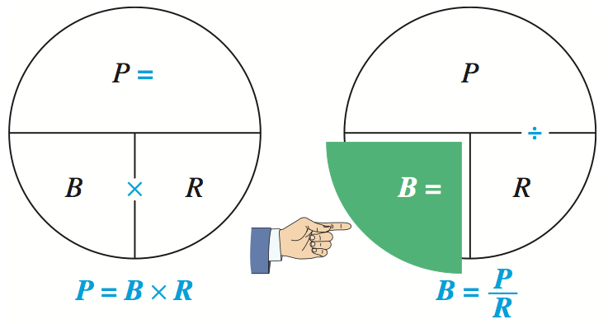
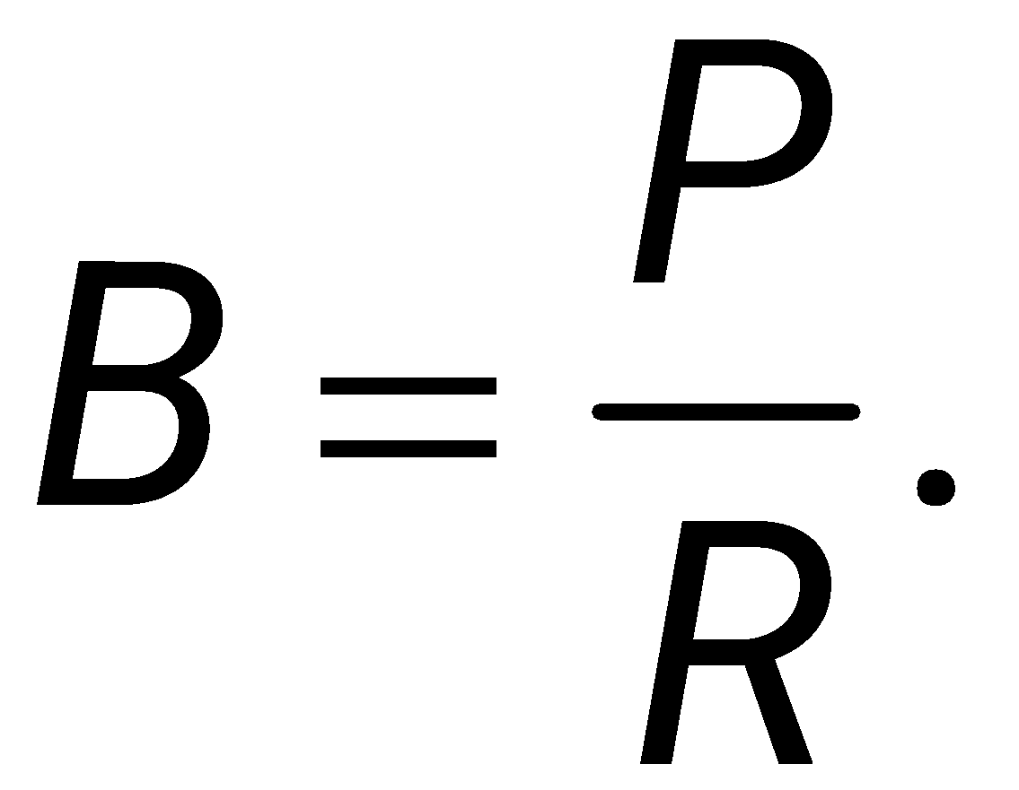
To find the formula for base, cover B with your finger.
This leaves P divided by R, so

Slide 54
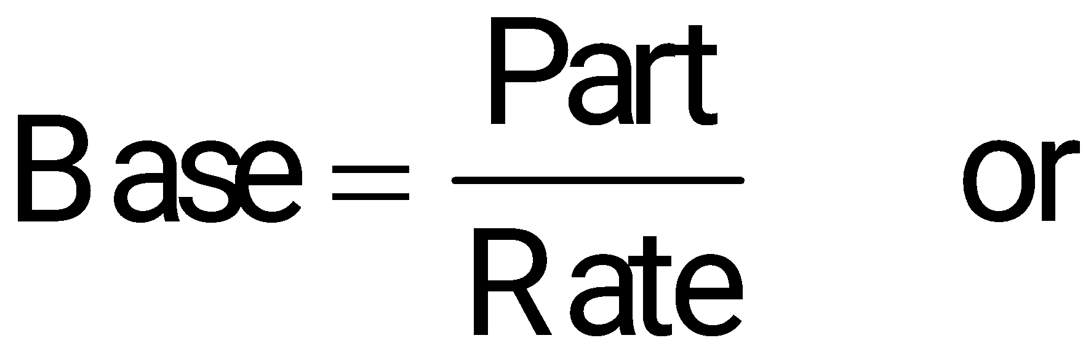
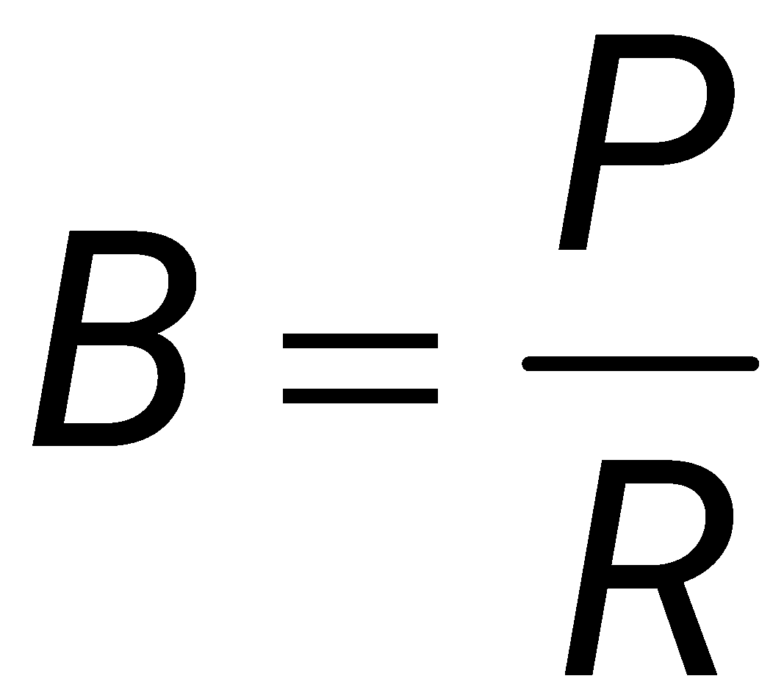
Use the Basic Percent Formula to Solve for Base

Slide 55
Example
Solve for base, using the formula
8 is 4% of ____
(b) 135 is 15% of ____
(c) 1.25 is 25% of ____

Slide 56
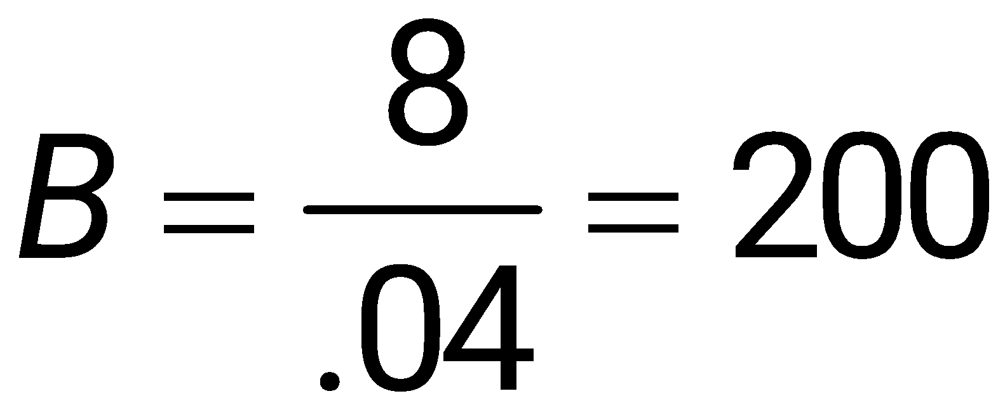
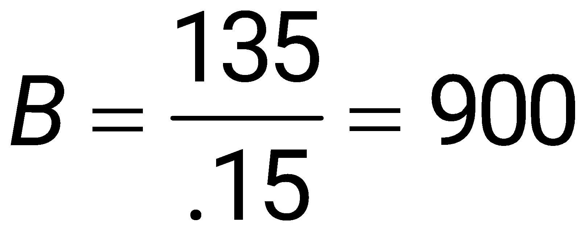
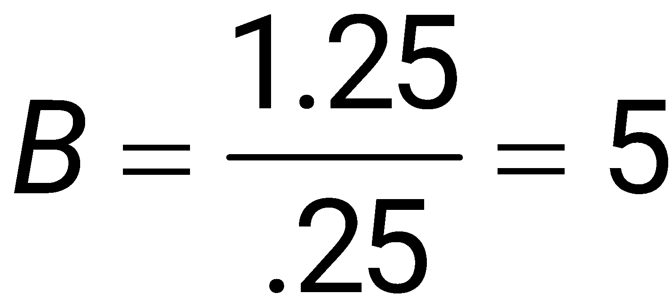
Example
(a) 8 is 4% of ____
(b) 135 is 15% of ____
(c) 1.25 is 25% of ____

Slide 57
Find Sales when Tax Amount and Tax are Known
In business problems involving sales tax, the amount of sales is always the base.
We use the formula

Slide 58
Example
One week, a Famous Footware store collected sales taxes of $780. If the sales tax rate is 5%, find total sales for the week.

Slide 59
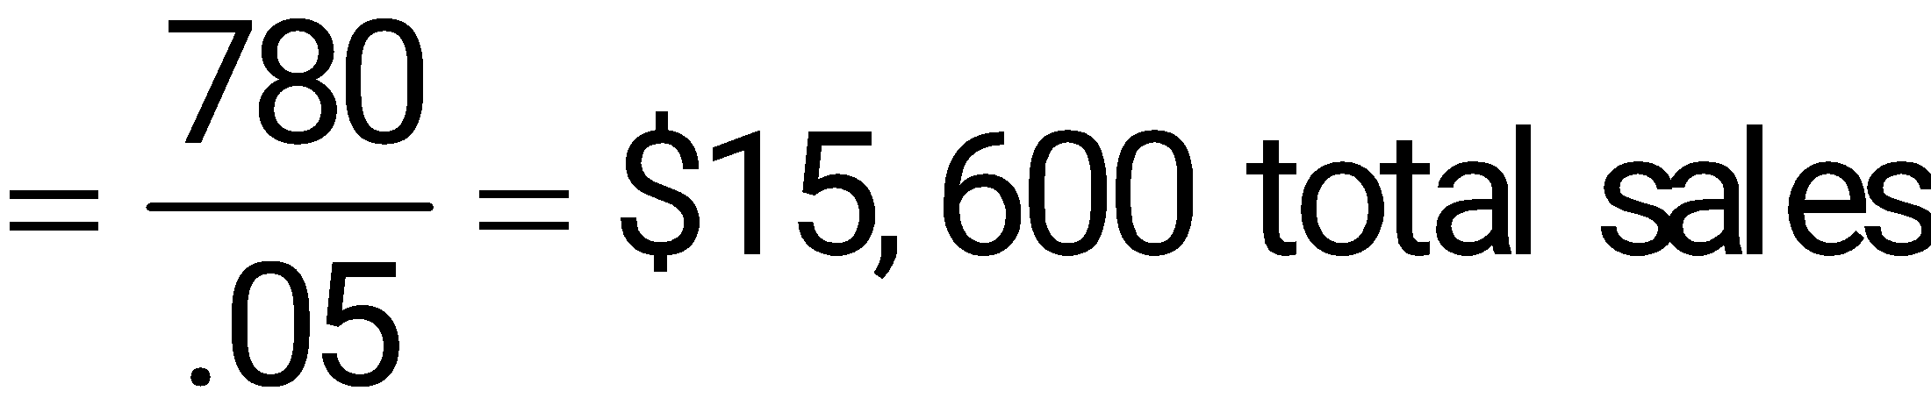
Example
The rate of tax collection is 5%, and taxes collected are a part of total sales. The rate in this problem is 5%, the part is $780, and the base, or total sales, must be found.
R × B = P
% of something is something
5% of total sales is $780 (tax)
Use the
formula:

Slide 60
Find the Investment when Interest Payment and Rate of Interest are Known
In problems involving investments, the amount of money invested is always the base.
We use the formula

Slide 61
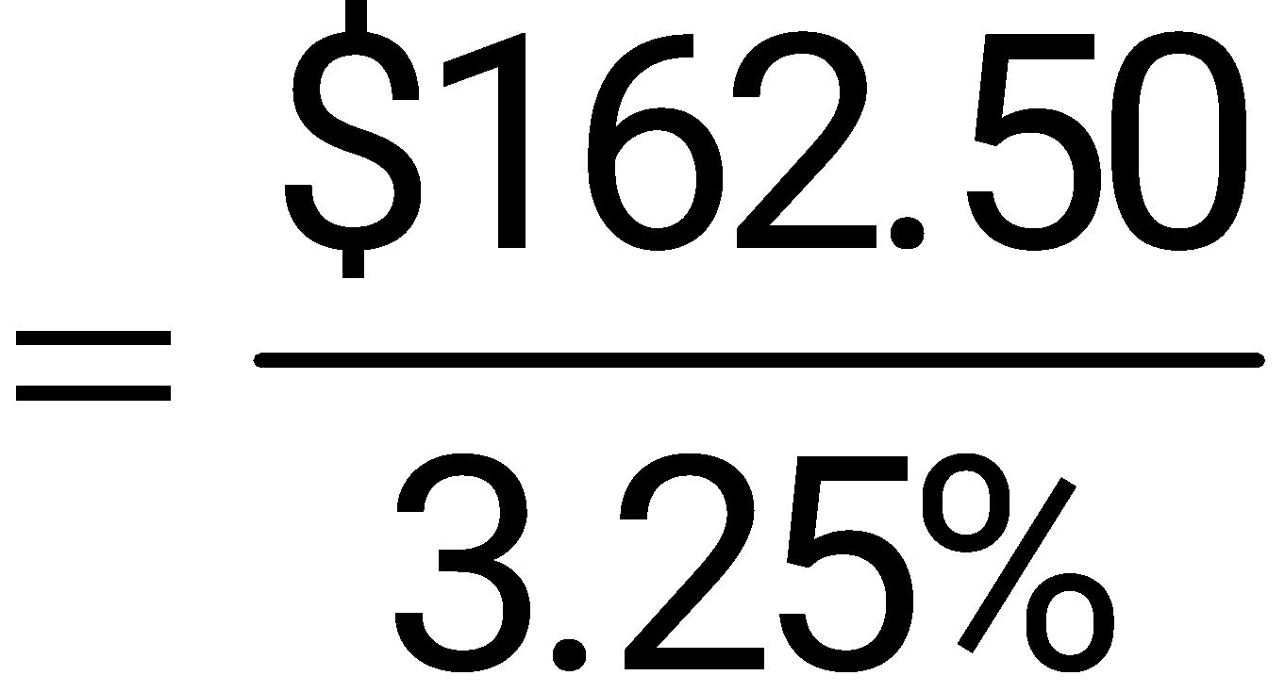


Example
Roberta Gonzales received $162.50 in interest from an account that paid 3.25% interest for the year. Find the amount of money invested in the account.
The part (P) is the $162.50 in interest and the rate (R) is 3.25%. The whole, or base (B), is unknown.
The original investment was $5000.

Slide 62
Use the Basic Percent Formula to Solve for Rate
Part and base are given, and the rate must be found.
The formula for rate is found from the formula P = B × R.
Use circle diagram on the next slide to learn how to use this formula.

Slide 63


Cover R.
We get part ÷ base, or

Slide 64


Use the Basic Percent Formula to Solve for Rate

Slide 65
Use the Basic Percent Formula to Solve for P, B, or R
Need to know the values of two of the three components.
To find P:
Use P = B × R.

Slide 66


Use the Basic Percent Formula to Solve for P, B, or R
To find R:
P = B × R.

Slide 67


Use the Basic Percent Formula to Solve for P, B, or R
To find B:
P = B × R.

Slide 68
Example
Solve for rate.
(a) 26 is ____% of 104
(b) ____% of 300 is 60
(c) 54 is ____% of 12

Slide 69



Example
(a) 26 is ____% of 104
(b) ____% of 300 is 60
(c) 54 is ____% of 12

Slide 70

Solve for Rate in Application Problems
In application problems, to find the rate,
we use the formula

Slide 71
Example
An investment officer at Graham Bank placed $3,000,000 in a government security. It remained there for one year and earned $96,000 in interest. Find the rate of return.

Slide 72

Example
The whole is $3,000,000 and the part is $96,000. Find the rate as follows.
The investment earned 3.2% for the year.

Slide 73

Example
One of the toughest races in the world is the 26.2-mile-long Boston marathon. After running 22 miles, Sheila James is exhausted. Find the percent of the race that she must still run.
Distance yet to be run
= 26.2 – 22 = 4.2 miles
James still has to run 16% of the total distance.

Slide 74
Learn to Identify an Increase or Decrease Problem
Businesses look at how amounts change, either up or down.
Business: percent by which sales have increased or decreased.
Consumer: percent by which an item has changed.

Slide 75
Identify an Increase Problem
The base (100%) plus some portion of the base gives a new value, which is the part.
an increase of
more than
greater than
Original + Increase = New value
(base) (part)

Slide 76
Identify a Decrease Problem
The part equals the base (100%) minus some portion of the base (gives new value).
after a decrease of
less than
after a reduction of
Original – Decrease = New value
(base) (part)

Slide 77

Apply the Basic Diagram for Increase Word Problems
A diagram, such as this one, can be used to help solve an increase word problem.

Slide 78
Use the Basic Percent Formula to Solve for Base in Increase Problems
To find the Rate, use
Original + Increase = New value
To find the Base, use

Slide 79
Example
The value of a home sold by Tom Dugally this year is $203,500, which is 10% more than last year’s value. Find the value of the home last year.

Slide 80
Example
The base is the starting point, or that to which something is compared. In this case the base is last year’s value. Call base 100%, and remember that
Original (base) + Increase = New value
Apply the basic diagram for an increase.

Slide 81
Example
The base is the starting point, or that to which something is compared. In this case the base is last year’s value. Call base 100%, and remember that

Slide 82


Example
Original + Increase = New value
100% + 10% = 110%
Substitute part = $203,500 and rate = 110%
The value of the house last year was $185,000.

Slide 83
Example
Due to increased demand for a patented process that will help analyze the DNA of mice, Biotics Genome has increased production of testing kits by 20% per year for each of the two past years. This year’s production is 93,600 kits. Find the number of kits produced two years ago.

Slide 84

Example
The two increases cannot be added together because the increases are from two different years, or two separate bases. The problem must be solved in two steps. First, use a diagram to find last year’s production.

Slide 85


Example
Part = 93,600 and
Rate = 100% + 20% = 120%
Production last year was 78,000 kits.

Slide 86

Example
Production for the preceding year (two years ago) must now be found.

Slide 87


Example
Part = 78,000 and
Rate = 100% + 20% = 120%
Production two years ago was 65,000 kits.

Slide 88

Apply the Basic Diagram for Decrease Word Problems
A diagram, such as this one, can be used to help solve a decrease word problem.

Slide 89
Use the Basic Percent Formula to Solve for Base in Decrease Problems
To find the Rate, use
Original – Increase = New value
To find the Base, use

Slide 90
Example
After Nike deducted 10% from the price of a pair of competition running shoes, Katie Small paid $135. What was the original price of the shoes?

Slide 91
Example
Use a diagram again, and remember that base is the starting point, which is the original price. As always, the base is 100%. Use the decrease formula.
Original (base) – Increase = New value
Apply the basic diagram for a decrease.

Slide 92
Example
The base is the starting point, or that to which something is compared. In this case the base is last year’s value. Call base 100%, and remember that

Slide 93


Example
Original – Increase = New value
100% – 10% = 90%
Substitute part = $135 and rate = 90%
The original price was $150.

